Slide 1
Lecture 20
Nick Rugai PhD

Slide 2
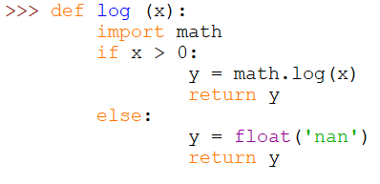
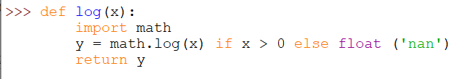
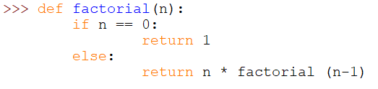

Review: Conditional Expressions

Slide 3
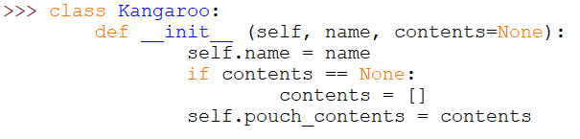
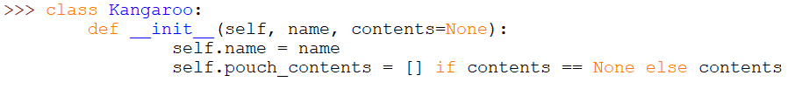
Review: Conditional Expressions

Slide 4

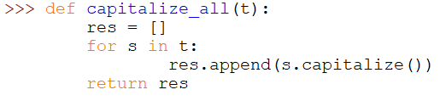
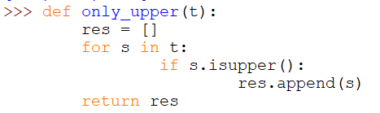

Review: List Comprehensions

Slide 5
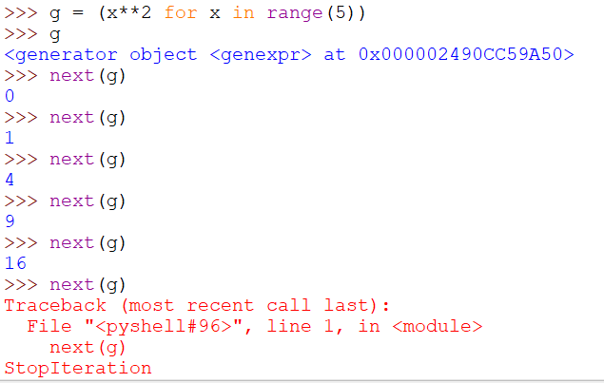

Generator Expressions

Slide 6

any and all

Slide 7
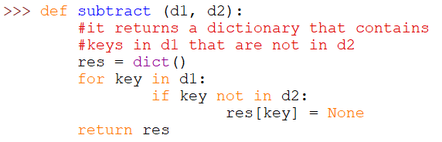

Sets

Slide 8
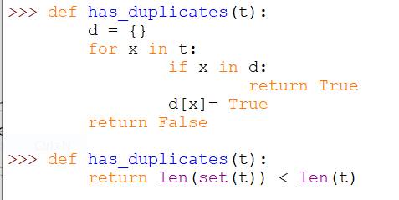
Sets
Because an element can only appear in a set once, if an element in t appears more than once, the set will be smaller than t.

Slide 9
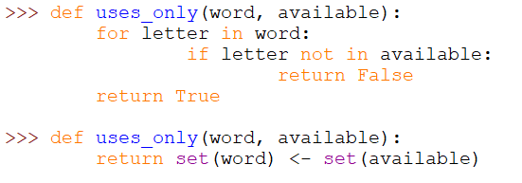
Sets
Check whether all letters in word are in available.

Slide 10
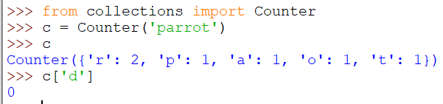

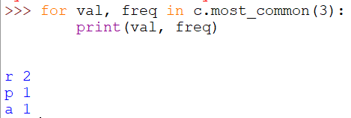

Counters
A counter is like a set but when an element appears more than once, the Counter keeps track of it. Counters need to be imported!
Unlike dictionaries, Counters do not raise an exception if an element does not exist.

